Slide 1



Columbia Hospital Analysis
Sonia.J

Slide 2

About
A well-known healthcare facility, Columbia Asia Hospital is a shining example of patient-centered care and medical expertise. The hospital is well-known for its dedication to offering top-notch medical care and has a global presence in several nations. Modern infrastructure, state-of-the-art medical technology, and a staff of highly qualified and caring healthcare professionals define Columbia Asia. In order to address the many requirements of the communities it serves, the hospital's ethos is centered on providing complete and individualized healthcare solutions. Columbia Asia Hospital is committed to providing excellent medical care and promoting a healthy and prosperous society. It has achieved this by adopting a patient-centric approach.

Slide 3
Analytical Approach and Tools
Data Transformation and Cleaning
Used Power Query Editor in Power BI to transform and clean data. Handled missing values and inconsistencies to ensure data integrity
Power Query Editor
Used Power Query Editor to shape and clean the Data. Carried out tasks including sorting, filtering and merging to improve the quality of Dataset.
DAX Functions
Employed DAX Functions for numerical measurements, such as Average, Sum, IF, IFBlank, Calculate, Switch, Max, Count.
Visualizations
Created interactive dashboards and reports using Power BI's visualizations. Implemented charts, tables, and tabular views for effective data presentation.
Strategic Decision-Making
Helped with strategic decision-making by offering useful insights and conducting patient demographic analysis. Computed departmental revenues and average waiting times using DAX tools.

Slide 4
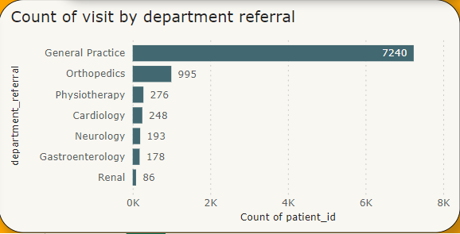
Total Visits by Department
The distribution of patient visits across the various departments can be seen in the bar chart, which makes the following visit counts visible: With 7240 visits, general practice is the most popular, followed by orthopedics (995), physiotherapy (276), cardiology (248), neurology (193), gastroenterology (178), and Renal (86).
With General Practice getting the most visits and Orthopedics coming in second, this graph clearly illustrates the relative popularity of each department and offers insightful information for the hospital's resource allocation and strategic planning.

Slide 5
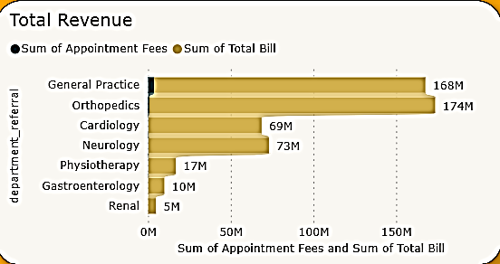
Total revenue
The departmental revenue appears in a column chart that highlights significant contributions. With $172.9M, Orthopedics is the largest, closely followed by General Practice at $164.1M. Contributions from cardiology and neurology are $72.8M and $68.4M, respectively. Gastroenterology, physiotherapy, and renal come next with $16.6M, $9.8M, and $4.8M, respectively. Within the hospital, this succinct depiction facilitates resource allocation and strategic decision-making.

Slide 6
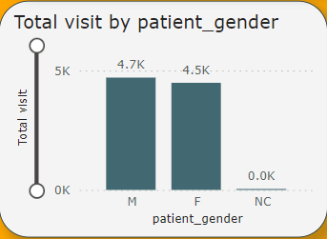


Gender Preference
4705
4487

Slide 7
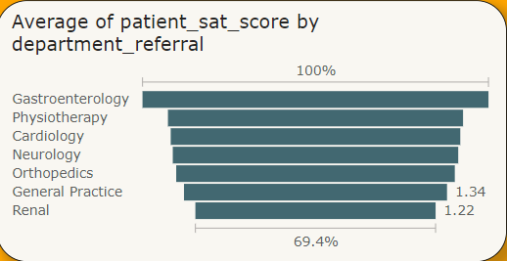
Average Satisfaction
Recommendations
To improve overall satisfaction, focus on enhancing ratings in Cardiology and Renal departments.
Implement targeted improvements, gather regular feedback, and foster a patient-centric culture.
• Gastroenterology leads with a strong 5.9 average satisfaction rating.
• Neurology and Physiotherapy follow closely at 5.6.
• Orthopedics and General Practice are slightly behind with 5.5.
• Cardiology and Renal exhibit ratings of 5.4 and 5.3, respectively.

Slide 8

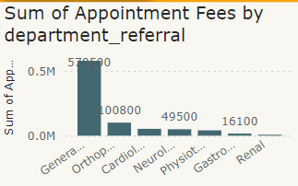
Appointment Fees
Total Doctors in Hospital
22
The appointment fees that doctors charged varied depending on the departments in which they worked.
Let's review the fees that these departments charge. The department with the highest fee of all is neurology, which charges $1,500. The departments with the lowest fees were General Practice and Renal ($500), Gastroenterology ($700), Orthopedics ($700), Cardiology ($1200), and Physiotherapy ($1000).

Slide 9
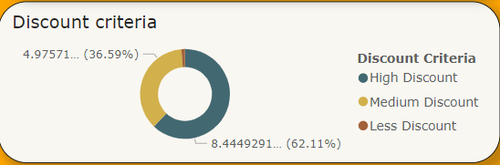
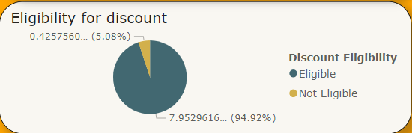
Discounts
The discount criteria was set according to the satisfaction scores by the patients.
Customer who gave scores less than 4 were eligible for less discount.
Who gave less than 7 were eligible for Medium discount.
High discount for those who gave more than 8 or above.
Eligibility for the discounts was set according to the rating which patients gave
Patients who gave the ratings below 5 were not eligible for the discounts.
Patients who gave the rating more than 5 were only eligible for the discounts.

Slide 10
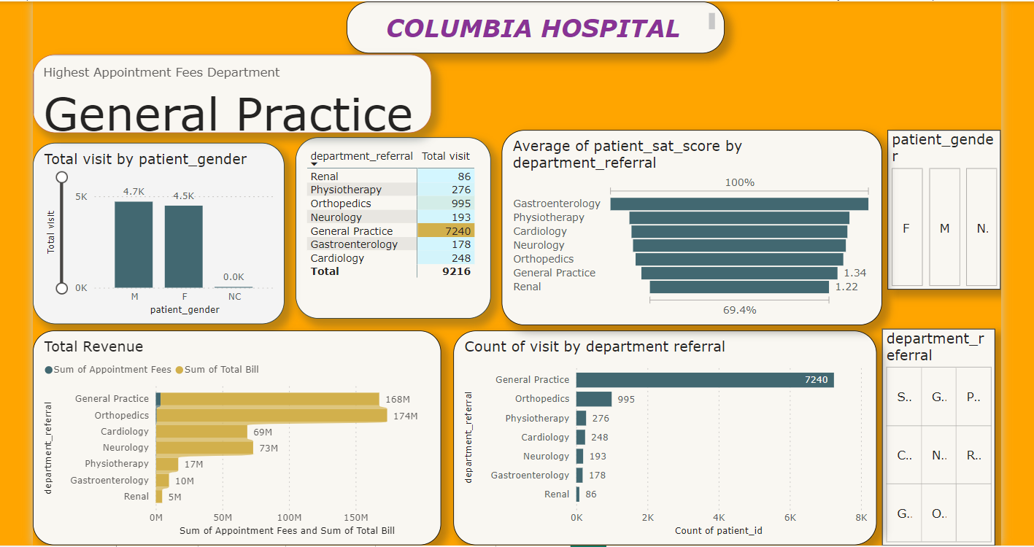
Dashboard and Visualizations
On this tab Hospital will be able to view all the metrics like number of daily visits, revenue produced, Satisfaction.
Added Slicers of gender and department from which we will be able to see the results according the particular departments and gender.

Slide 11
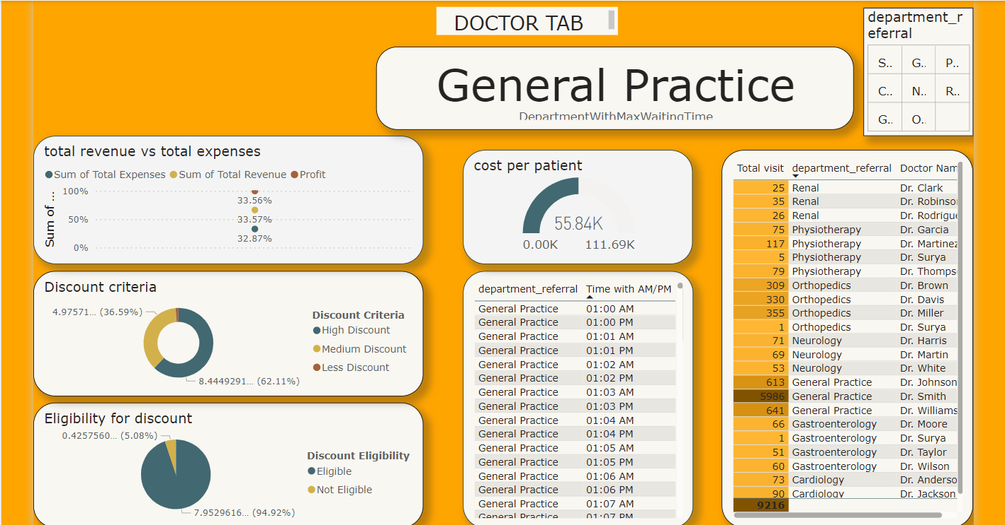
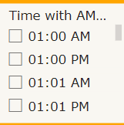
Doctor’s Tab
Individual doctor’s performance metrics will be visible here like customer satisfaction, number of patients visited, revenue generation.
I have added slicer of department and time to view metrics as per time.

Slide 12
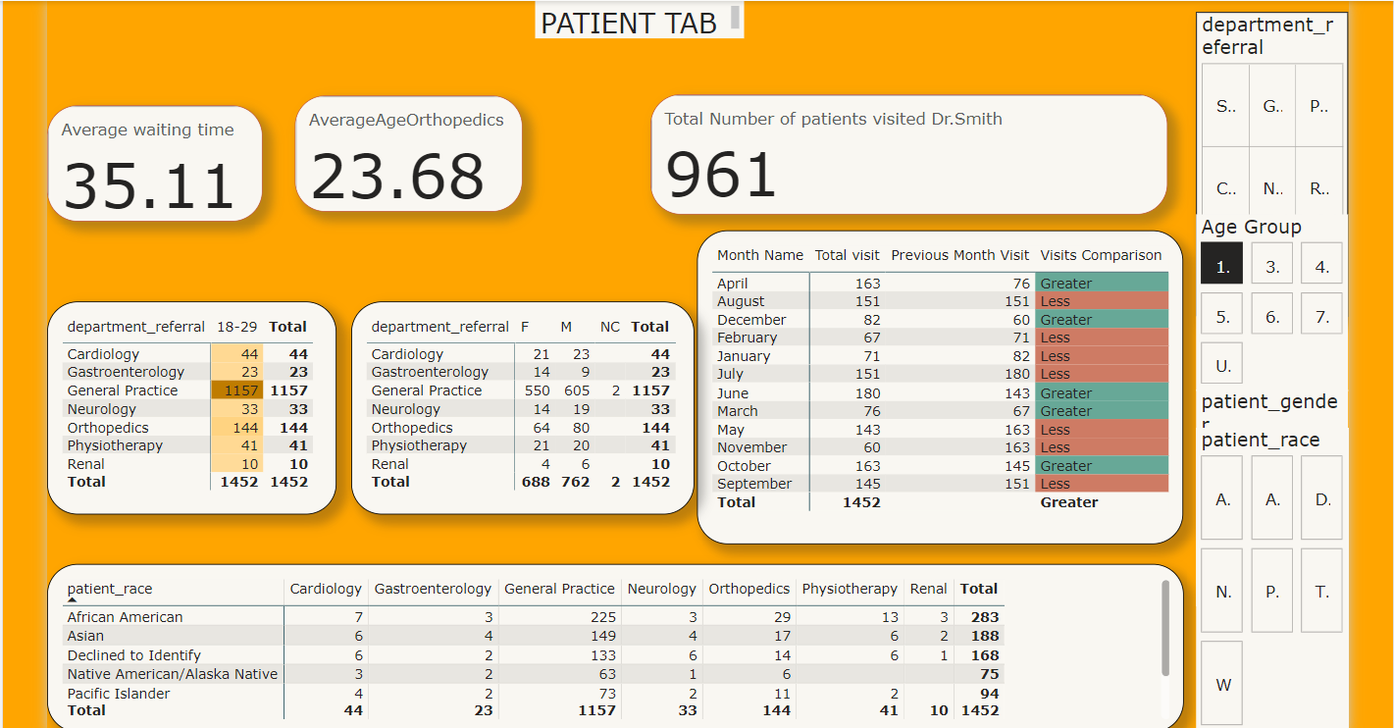
Patient’s Tab
This tab is built for viewing the patient demographics which will be including some metrics like Department visited, race, gender, etc.
I have added slicer of department,age,gender and race to view profile as per every patient.

Slide 13

Interactive dashboards with slicers and filters for date ranges and referral patterns are a feature of Power BI reports. Interacting with visualizations allows users to obtain more profound understanding.
Key Insights and Recommendations:
Patient Satisfaction Improvement: It may be possible to focus improvement efforts on departments that routinely receive lower satisfaction ratings, maybe by implementing better wait times or communication.
Optimize Resource Allocation: To improve patient experience and shorten wait times, departments with long patient wait times may need to hire more staff or optimize their processes.
Strategic Partnerships: Finding department referral patterns on a regular basis can result in shortened patient pathways and strategic alliances for better care delivery.
Conclusion:
I turned raw data into useful insights with this Power BI-based analysis. The interactive dashboards, visualizations, and critical recommendations help hospital managers and healthcare workers make data-driven choices, optimize emergency room operations, and improve patient care.

Slide 14

Thankyou

